Slide 1
Big Mountain Resort Pricing Stategy
Jeremy Quach

Slide 2
New Chairlift Installation
Big Mountain Resort (BMR) recently installed an additional chair lift to increase daily distribution of visitors across their mountain
Renovations increased annual operating costs by $1,540,000
How can Big Mountain Resort increase profits in the upcoming season to bring in at least an additional $1,540,000 in revenue to offset the installation of their new chairlift?

Slide 3
Key Findings
What do consumers look for in a resort?
Fast Quad Ski lifts
Runs
Snow Making
Vertical drop heights
BMR is underselling it's tickets by $14.06 dollars according to predictive models (±$10.32)
Permanently closing down 5 runs can reduce operating costs
Increasing vertical drop by 150 feet yields $0.99 support to ticket prices
expected $1,724,638 by the end of the season

Slide 4
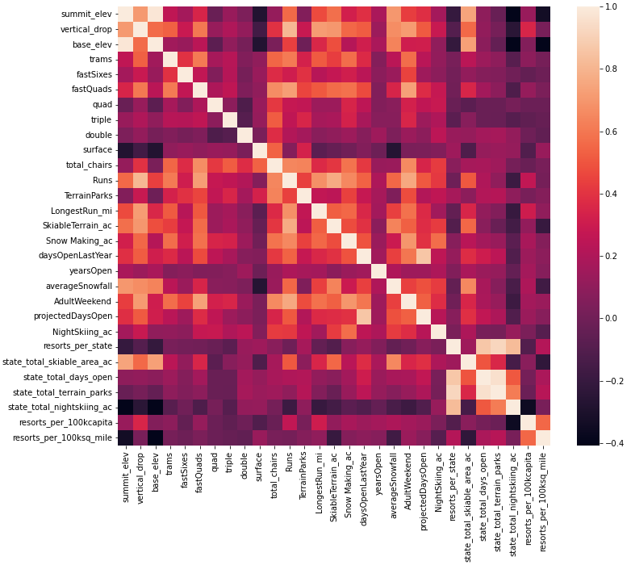
Feature Correlation Heatmap
Strongest correlations to ticket prices found in:
fastQuads
Runs
Snow Making_ac
resort_night_skiiing_state_ratio

Slide 5
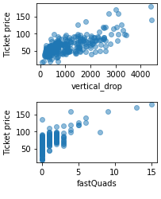
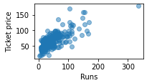
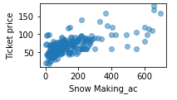
Important features

Slide 6
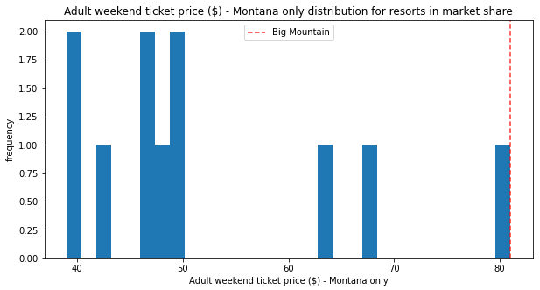
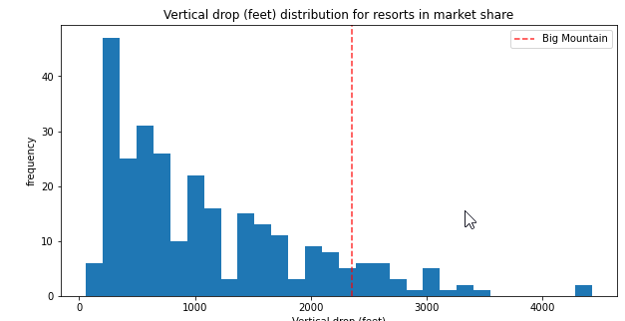
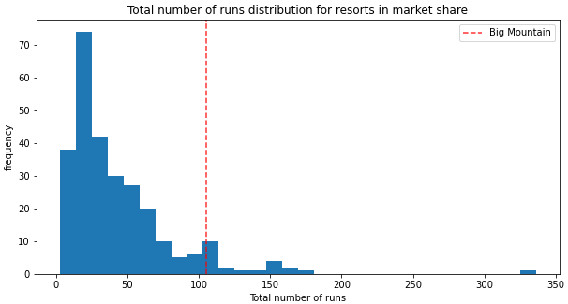
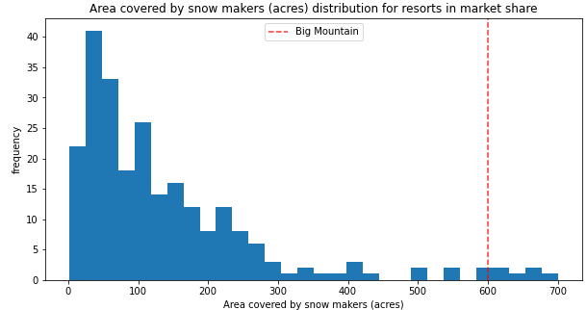
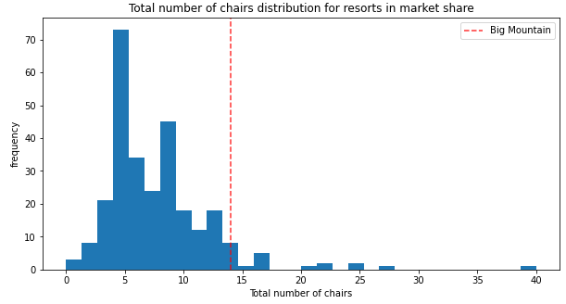
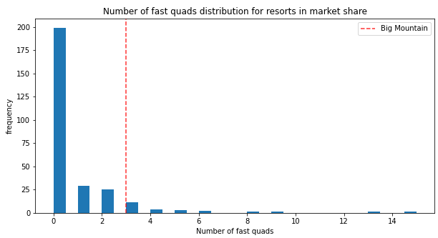
Montana Ski Resort Price Distribution
BMR current price is higher than most other resorts
BMR vertical drop is competitive but there are some higher
BMR snowmaking is above the curve
BMR boasts high number of total chairs and Fast Quads
BMR compares wells in number of runs

Slide 7
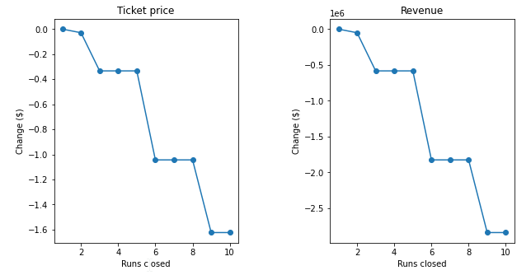
Closing Down Runs
Closing 1 makes no difference
Closing 2 and 3 successively reduces support for ticket price and revenue
Closing 4 and 5 inquires no further loss
Closing +6 leads to larger losses

Slide 8
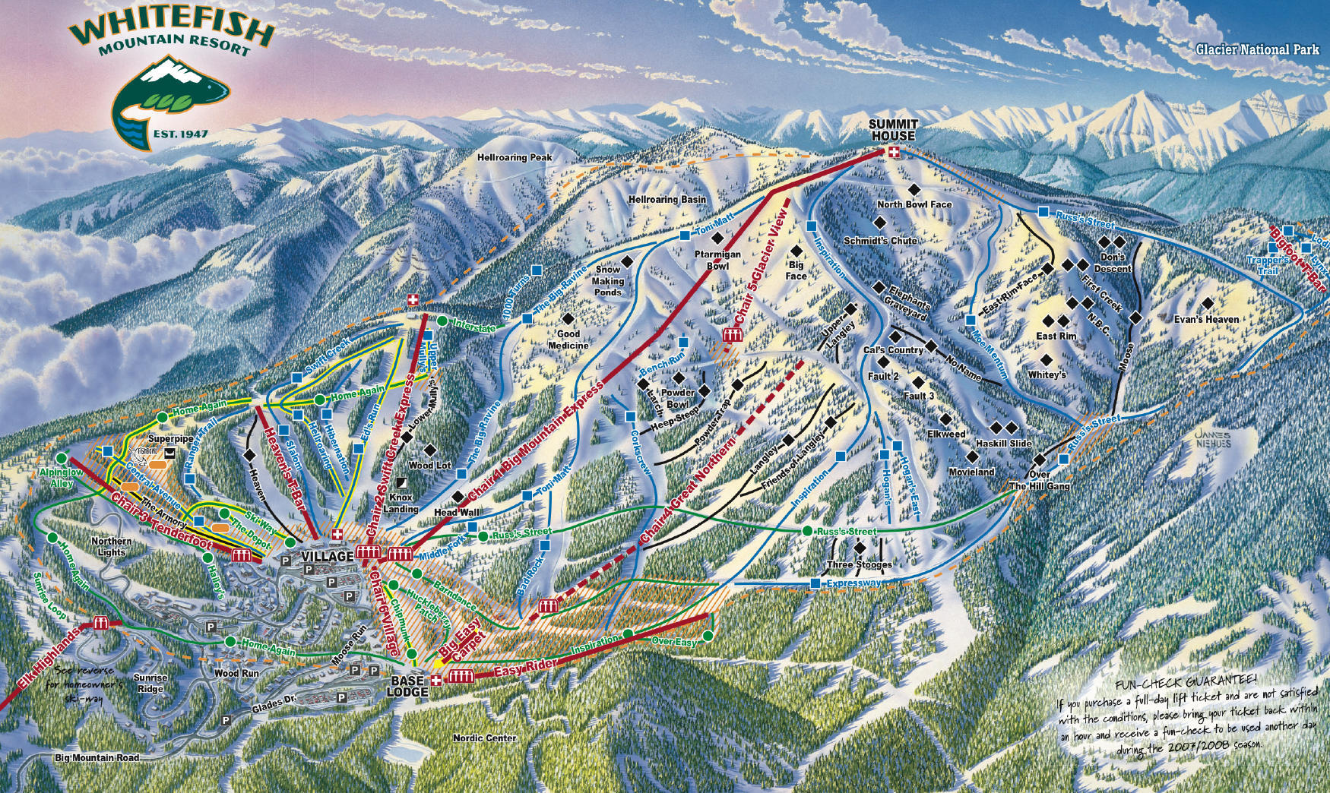
Vertical Drop Increase
Increase vertical drop by adding a run to a point 150 feet lower down
Requires the installation of an additional chair lift to bring skiers back up
No additional snow making coverage required

Slide 9
Summary
Increase the price by a margin of $14 would increase seasonal revenue by $24,500,000
Extending the height of the vertical drop would increase seasonal revenue by $1,724,638
Market the key features of Big Mountain Resort
Do not close more than 5 ski runs

